Slide 1


Mini-Project Ideas
"Exploring Possibilities: Mini Project Ideas for Building Practical Experience"
Guided by :-
Prof Ms. M .P. Chaudhary mam
Presented by :-
Sonali Kotlapure
Gayatri Suryawanshi
Sakshi Rithe

Slide 2

Purpose of the Presentation
This presentation aims to elucidate the scope and intentions behind the E-waste Facility Locator and Interlink between Startup & Investors Platform.
Environmental Growth
Entrepreneurial Excellence
Innovative solutions for sustainability and debris management.
Strategies crafted for the success and agility of budding startups.

Slide 3

Overview of Mini Project Ideas
Dive into an overview of initiatives that seek to revolutionize waste management and streamline startup operations.
Predicting
Street Parking
Availability
E-waste Locator
Startup Strategy
Predicting the availability of
street parking spots in a
given area at a specific time
involves creating a machine
learning model that can
finding an empty parking
spot at different locations
and times
A digital platform guiding disposal and recycling of electronic waste.
A toolkit fostering organizational and strategic growth for new ventures.

Slide 4
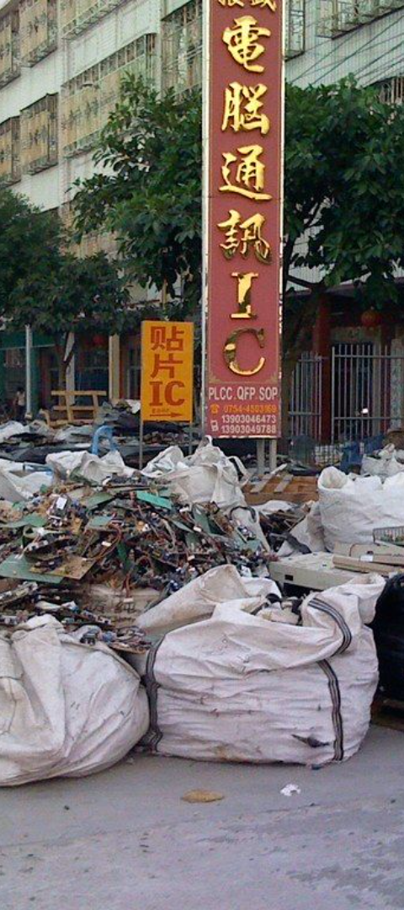
5yhh
1. E-waste Facility Locator
Introducing a tech-solution to efficiently connect consumers with local e-waste facilities, promoting responsible disposal and recycling.
1
𝐋𝐨𝐜𝐚𝐭𝐢𝐨𝐧-𝐁𝐚𝐬𝐞𝐝 𝐄-𝐖𝐚𝐬𝐭𝐞 𝐅𝐚𝐜𝐢𝐥𝐢𝐭𝐲 𝐋𝐨𝐜𝐚𝐭𝐨𝐫
enables to find the nearest E-Waste Facility Center.
2
𝐄𝐧𝐡𝐚𝐧𝐜𝐢𝐧𝐠 𝐅𝐚𝐜𝐢𝐥𝐢𝐭𝐲 𝐈𝐧𝐬𝐢𝐠𝐡𝐭𝐬
provides valuable insights to E-Waste Facility Centers with unstable customer interactions, helping them improve their services and operations.
3
𝐌𝐋 𝐚𝐧𝐝 𝐀𝐈-𝐃𝐫𝐢𝐯𝐞𝐧 𝐂𝐫𝐞𝐝𝐢𝐭 𝐏𝐨𝐢𝐧𝐭𝐬
calculate credit points based on the quality and type of e-waste and the precious metals within it. Users can redeem these points for discounts, deals, coupons, and prizes in third-party apps.
4
𝐑𝐚𝐢𝐬𝐢𝐧𝐠 𝐀𝐰𝐚𝐫𝐞𝐧𝐞𝐬𝐬
website doesn't stop at functionality – it also spreads awareness among users and citizens through up-to-date news articles.
5
𝐄𝐚𝐬𝐲 𝐁𝐨𝐨𝐤𝐢𝐧𝐠 𝐨𝐟 𝐄-𝐖𝐚𝐬𝐭𝐞 𝐏𝐢𝐜𝐤𝐮𝐩𝐬
Schedule appointments for E-Waste pickups effortlessly. AI and ML algorithms classify uploaded images of the devices, ensuring the right vehicle is dispatched for collection.

Slide 5

Community Forums of Discussion Boards
Solution Approach
you can create a more comprehensive and engaging e-waste facility locator platform that not only helps users find disposal but also encourages active participation in e-waste recycling efforts.
1
find the nearest E-Waste Facility Center
2
Gamification Elements
3
Notification System
4
Community Forums of Discussion Boards
5
Live Chat Bot Support
6
Social Sharing
7
Schedule appointments for E-Waste pickups

Slide 6

2. Interlink between startup and investors
In the fast-paced world of entrepreneurship, startups often struggle to find suitable investors who share their vision and can fuel their growth.
The startup-investor landscape is fragmented, lacking a centralized platform for efficient connections and collaboration.
Focus on Facilitating Efficient Collaboration and Growth.
gs

Slide 7

Developing Process of interlink between startup and investors
1
Market Research
2
Choose the Right Technology Stack
3
Design UI
4
Database Design
5
User Authentication and Authorization
6
Pitch Submission and Matching Algorithms
7
Messaging System
8
Document Management
9
Testing
10
User Support and Feedback
11
Iterate and Improve
12
Community Building

Slide 8
User Interface
Homepage :- 1.Clean Landing Page 2. Navigation Bar
User Profile :- 1. User Dashboard 2. Profile Customization
Pitch Submission :- 1. Form Interface 2. Validation
Investor Interaction :- 1. Expression of interest 2. Match Pitches
Notifications :- Real-time alerts
Messaging system :- 1.Inbox design 2. Threaded Conversations
Feedback Mechanism :- 1. Rating System 2. User Surveys
Analytics Dashboard :- 1. Metrics Display 2. Data Visualization

Slide 9
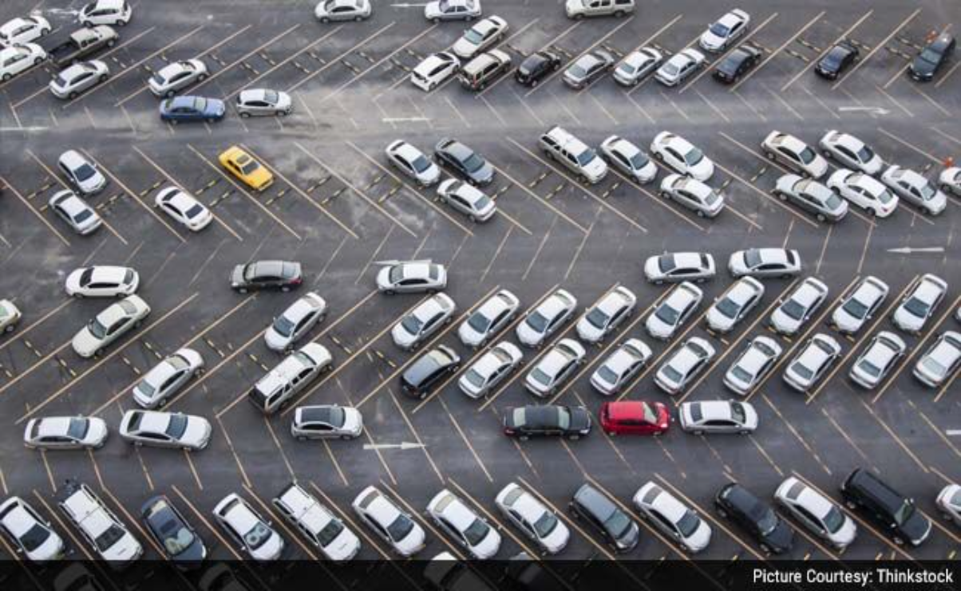
3. Predicting Street Parking Availability

Slide 10
Problem Statement
1
2
To develop a machine learning model that accurately predicts the availability of street parking spots in a given area at a specific time.
To provide a solution that helps reduce traffic congestion, save time, and improve urban mobility for residents and visitors

Slide 11
Solution Approach:
1
2
Data Collection:
Gather historical parking data
Data Preprocessing: Clean and preprocess the collected data
3
4
Model Selection and Training:
Select appropriate machine learning models for regression tasks, such as Linear Regression, Decision Trees.
Deployment:
Develop a web interface where users can input their location and desired time to receive parking availability predictions.

Slide 12
Conclusion
E-waste Facility Locator
Startup Management Strategy
The development of an e-waste facility locator addresses a critical need in managing electronic waste efficiently, promoting environmental sustainability, and fostering responsible recycling practices
For startup investors, recognizing the potential of such ventures underscores the importance of investing in innovative solutions that align with environmental goals while offering promising returns on investment.
Predicting Street Parking Availability
By accurately predicting parking availability, we can help reduce traffic congestion, lower vehicle emissions, and improve the overall quality of life in urban areas.

Slide 13
Thank you

